Slide 1
Classification of Amazon Reviews
By: Jorge Armando Barrera Ceballos

Slide 2
Index
Introduction
Data Description
Data Preprocessing
Feature Selection
Classification
Model Evaluation
Most Important Features

Slide 3
Introduction
Classification analysis of Amazon reviews was carried out for the Musical instruments category, using different classification and feature selection methods.
Databricks was used because the number of reviews contained in the data set is greater than 1,500,000.
It is important to know which words are most related to positive and negative reviews.
The Logistic regression method resulted as the best model, achieving classification metrics close to 90%.

Slide 4
Data Description
The data analyzed is made up of 1,511,178 Amazon reviews of Musical instruments.
The dataset contains the following variables:
Overall: rating from 1 to 5 given by the client in the review
ReviewerName: name of the person who made the review
ReviewText: full text of the review
Summary: summary of the review
The size of the file containing the database is 0.5 GBs.
The data was obtained from the website Amazon Review Data (2018), by Jianmo Ni from the University of California at San Diego, and is available at the following link :
Amazon review data (nijianmo.github.io)

Slide 5
Data Preprocessing
The following steps were performed to prepare the data for analysis:
Elimination of missing data – 1,511,172 reviews left
From the Overall variable, a dichotomous variable called labels was created to indicate whether the review is positive or negative.
The number of cases in each category is presented in the following table:
Overall | Label | Number of reviews | Percentage
1 to 3 | 0 (negative) | 290,973 | 19.3%
4 and 5 | 1 (positive) | 1,220,199 | 80.7%

Slide 6
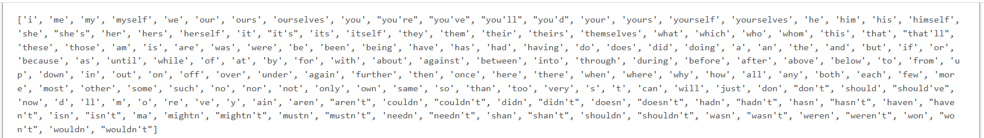
Data Preprocessing
The following transformations were made to the ReviewText variable prior to analysis:
Translation: punctuation marks were removed from reviews.
Lowerization: all letters were converted to lowercase.
Tokenization: each review was divided into substrings.
Stop words: the words considered “stop” in the English language were eliminated.
Lemmatization: The lemma of a word was determined based on its intended meaning and its context. E.g. “better” has “good” as its lemma, and “walk” is the base of “walking” (Wikipedia: Lemmatization).

Slide 7
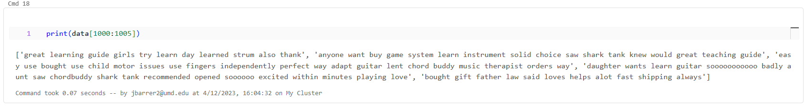
Data Preprocessing
These are some reviews after translation, lowerization, tokenization, “stop” words removal, and lemmatization:

Slide 8
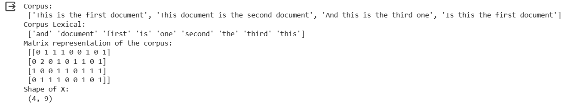
Data Preprocessing
The reviews were converted into a matrix of TF–IDF features.
TF = Term Frequency and IDF = Inverse Document Frequency.
The algorithm first counts the number of times a word appears and creates a matrix (TF) (from Scikitlearn) :

Slide 9
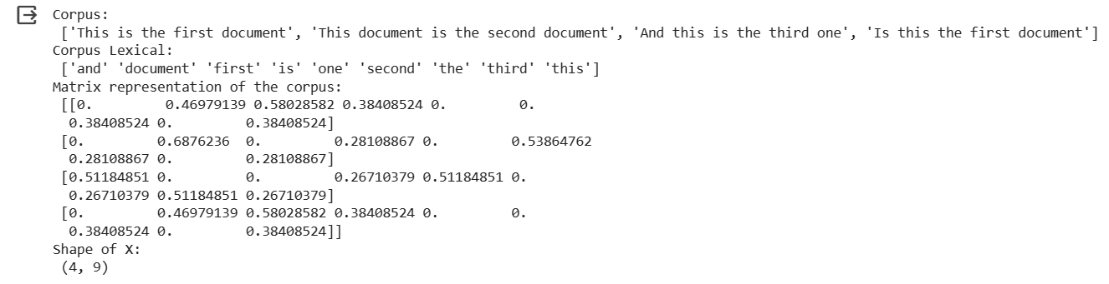
Data Preprocessing
It then assigns a weight according to the relevance of each word (IDF) - so very frequent words have a lower TF-IDF.

Slide 10
Feature Selection
For this stage, the following methods available in Scikit-learn were considered:
SelectKBest
Discards features that are independent of the class and will not be relevant for classification.
TruncatedSVD
Linear dimensionality reduction – very efficient for sparse matrices.
n-grams
Series of adjacent words that were considered in the classification methods. In this project 2- grams and 3-grams were used.

Slide 11
Classification
Naives Bayes and Logistic Regression classification methods were used.
The data was separated into training data (70%) and testing data (30%).
To prevent overfitting, k-fold cross-validation with k = 5 was used.
Because the review labels are a bit unbalanced, stratification by label (positive or negative) was used in the cross-validation.
The analysis was performed in Databricks using the Python interpreter.

Slide 12
Model Evaluation
The following evaluation metrics were used:
Accuracy
Percentage of cases correctly classified
Precision
The ability of the classifier to not label as positive a sample that is negative (from Scikit-learn)
Recall
The ability of the classifier to find all the positive samples (from Scikit-learn)
Receiver Operating Characteristic Area Under the Curve (ROC AUC)
Overall performance of the classifier

Slide 13
Model Evaluation
Model | Feature Selection | Accuracy | Precision | Recall | ROC AUC
Naive Bayes | SelectKBest (k = 1000) | 0.83 | 0.82 | 0.83 | 0.70
 | SelectKBest (k = 1000) + Trucated SVD (n = 200) | 0.79 | 0.82 | 0.79 | 0.72
 | SelectKBest (k = 1000) + 2-gram | 0.86 | 0.85 | 0.86 | 0.68
 | SelectKBest (k = 1000) + 3-gram | 0.83 | 0.82 | 0.83 | 0.59
Logistic Regression | SelectKBest (k = 1000) | 0.89 | 0.88 | 0.89 | 0.77
 | SelectKBest (k = 1000) + Trucated SVD (n = 200) | 0.87 | 0.86 | 0.87 | 0.72
 | SelectKBest (k = 1000) + 2-gram | 0.85 | 0.85 | 0.85 | 0.64
 | SelectKBest (k = 1000) + 3-gram | 0.82 | 0.83 | 0.82 | 0.53

Slide 14
Model Evaluation
Model | Feature Selection | Time to run in Databricks
Naive Bayes | SelectKBest (k = 1000) | 30.6 seconds
 | SelectKBest (k = 1000) + Trucated SVD (n = 200) | 3.52 minutes
 | SelectKBest (k = 1000) + 2-gram | 1.46 minutes
 | SelectKBest (k = 1000) + 3-gram | 2.94 minutes
Logistic Regression | SelectKBest (k = 1000) | 58.6 seconds
 | SelectKBest (k = 1000) + Trucated SVD (n = 200) | 5.14 minutes
 | SelectKBest (k = 1000) + 2-gram | 1.85 minutes
 | SelectKBest (k = 1000) + 3-gram | 3.24 minutes

Slide 15
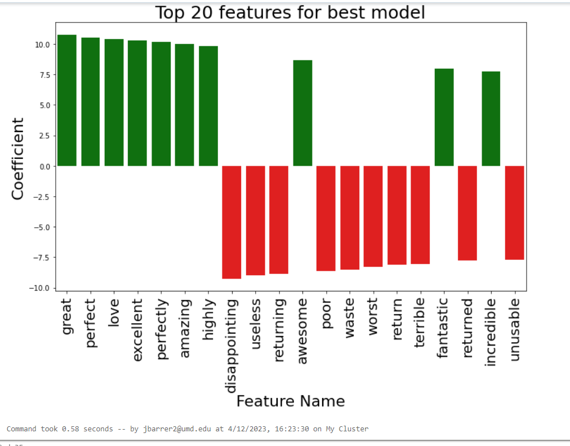
Most Important Features

